Slide 1

DRONE.Delivery
Dev Planning & BluePrint

Slide 2
CONTENTS
1 | Background SS
2 | Description MMH
3 | ER-Diagram MMH
4 | Entities & Attributes SS
5 | GUI SS
6 | Comparison Analysis MM
7 | Impact on Community MM

Slide 3
LET’S Begin

Slide 4
01
Background

Slide 5
Planning
Logical Execution
Development

Slide 6
02
Description

Slide 7
There are selected warehouses with certain number of drones available for each of them. The warehouses receive orders directly from customers along with the required customer details. The drones are then used to send these parcels from the respective warehouse selected according to the postal code of the customer .Each drone would deliver only one order at a time to avoid any security issues.
A software is being used to monitor all drones along with their information e.g. drone id , type of drone etc. It has records of all the drones assigned to the warehouse’s keeping track of their location at all times. If the destination address is some restricted area or weather at the time is not feasible for flight. This software would alert the drone to delay flight or even abort in case of a restricted area.

Slide 8
03
ER-Diagram

Slide 9
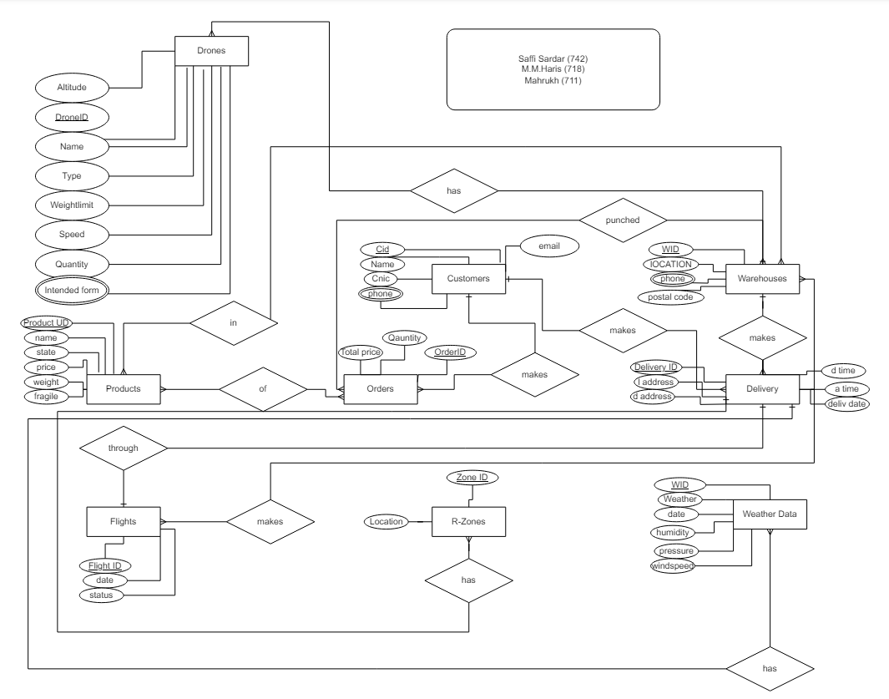

Slide 10
04
Entities & Attributes

Slide 11
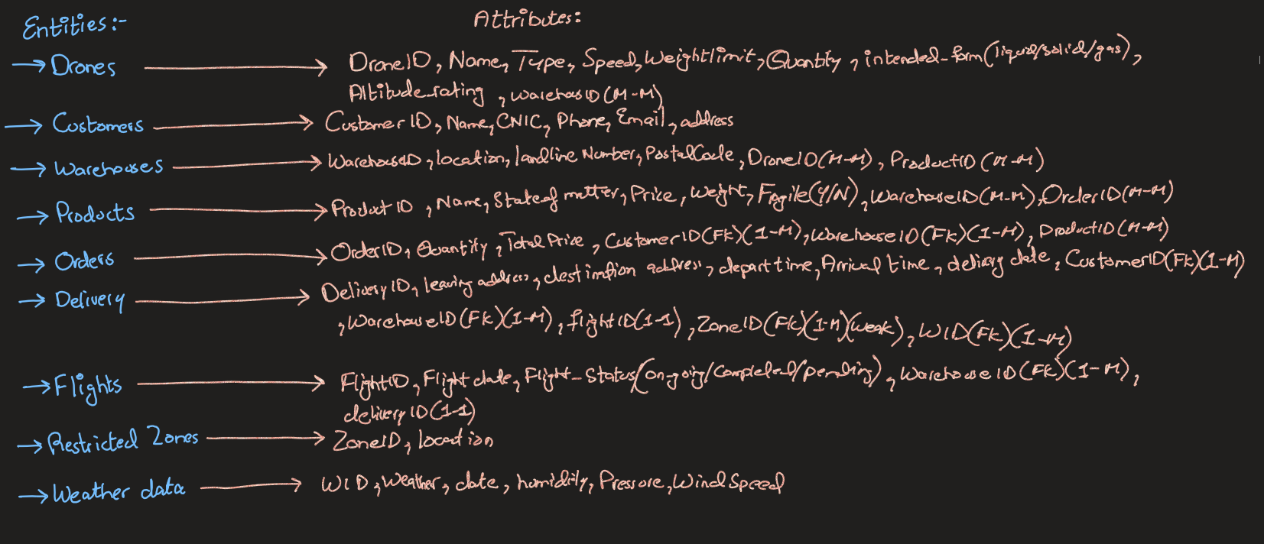

Slide 12
05
GUI

Slide 13
FLOW
User End
Back-End
01
02

Slide 14
Let’s get to Figma!
https://www.figma.com/design/0b5dCP3ZSHKrlcMA1Bk9Dt/Drone-Delivery-x-Store?t=I2dyGf47z1VXd032-1

Slide 15
06
Comparison Analysis

Slide 16
Our Competitor’s Regions
Drone Express (Ohio)
Sky Courier (Romania)
Aero Drone (India)
Drone.Delivery (PAK)

Slide 17
Comparison Analysis
 | Drone Express | Sky Courier | Aero Drone | Drone.Delivery
TRACKING | H | L | L | H
Delivery time | H | L | L | L
System platform | Android | Web | Android | Android
All time delivery | 24H | 24H | 24H | 24H
Data Analysis | Detailed | Detailed | Detailed | Detailed
Intercity deliveries | Yes | Yes | Yes | Yes

Slide 18
07
Impact on Community

Slide 19

Impact
Reaching the Unreachable/accessibility
Speed and Efficiency
Reduced Costs
Emergency response
Environmental benefits
Innovation and economic growth

Slide 20
Grp Members
M.M.Haris(718)
Saffi Sardar(742)
Mahrukh Malik(711)

